Slide 1


What’s For Dinner Tonight?
Produce-2-Recipe: a Recipe-Finder Using Images of Produce
Jhonsen Djajamuliadi
Project #5

Slide 2
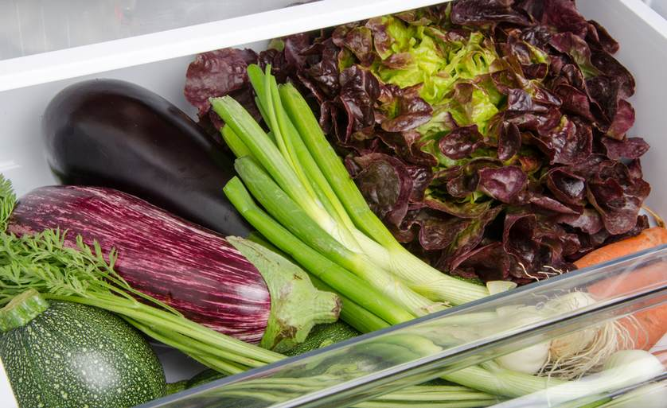
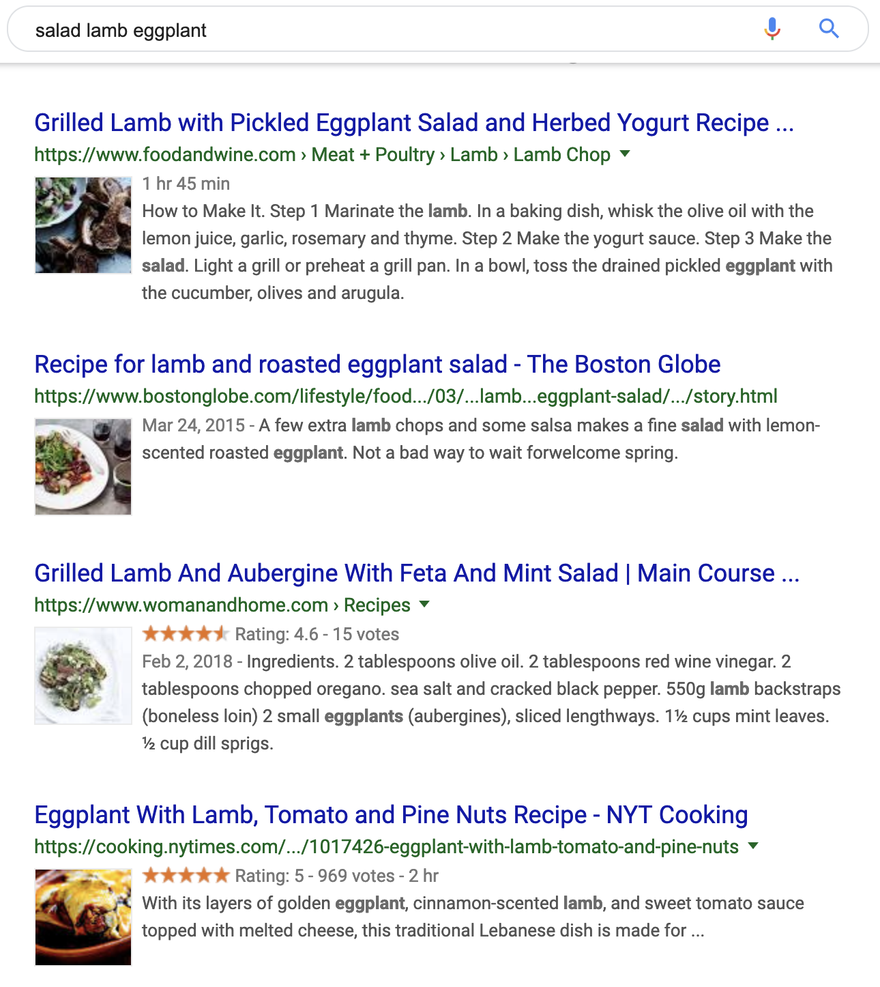
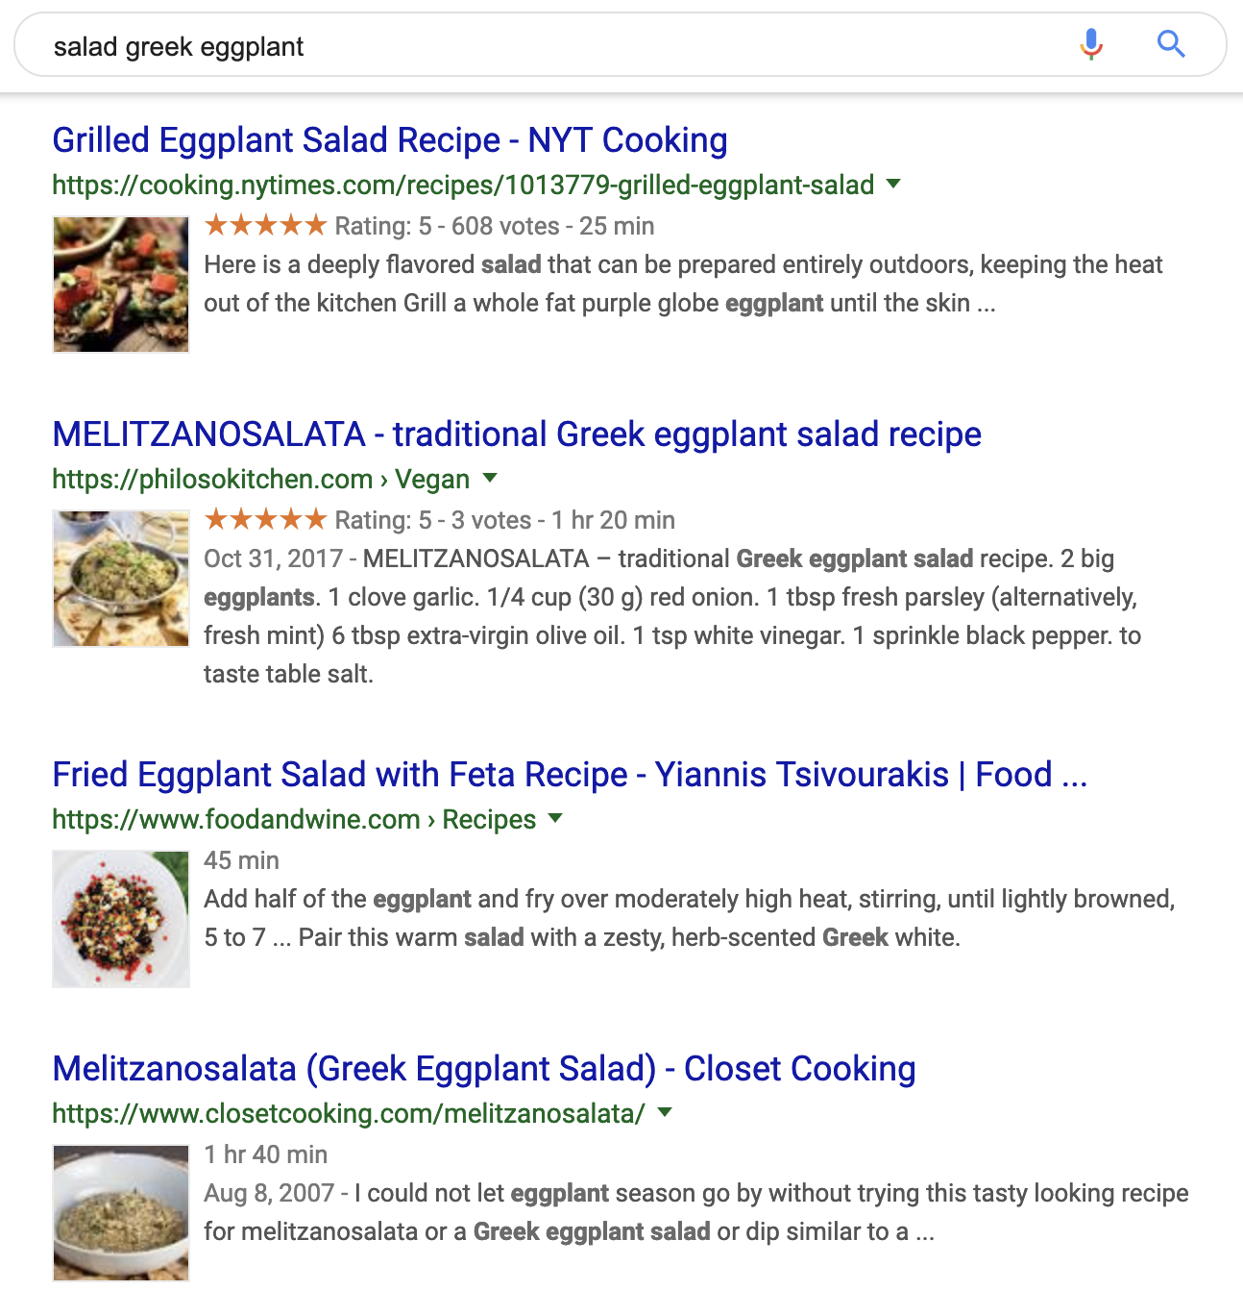

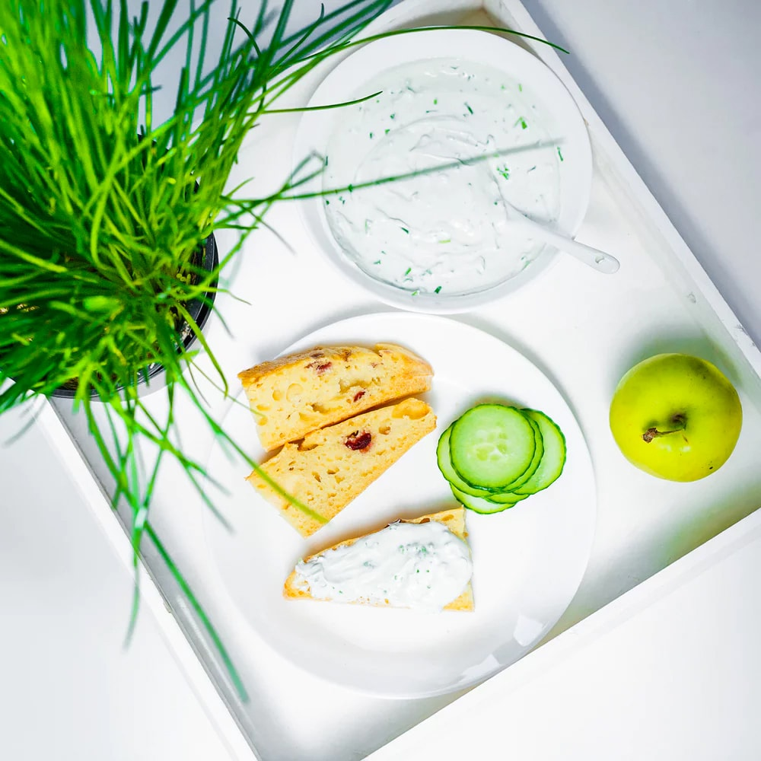
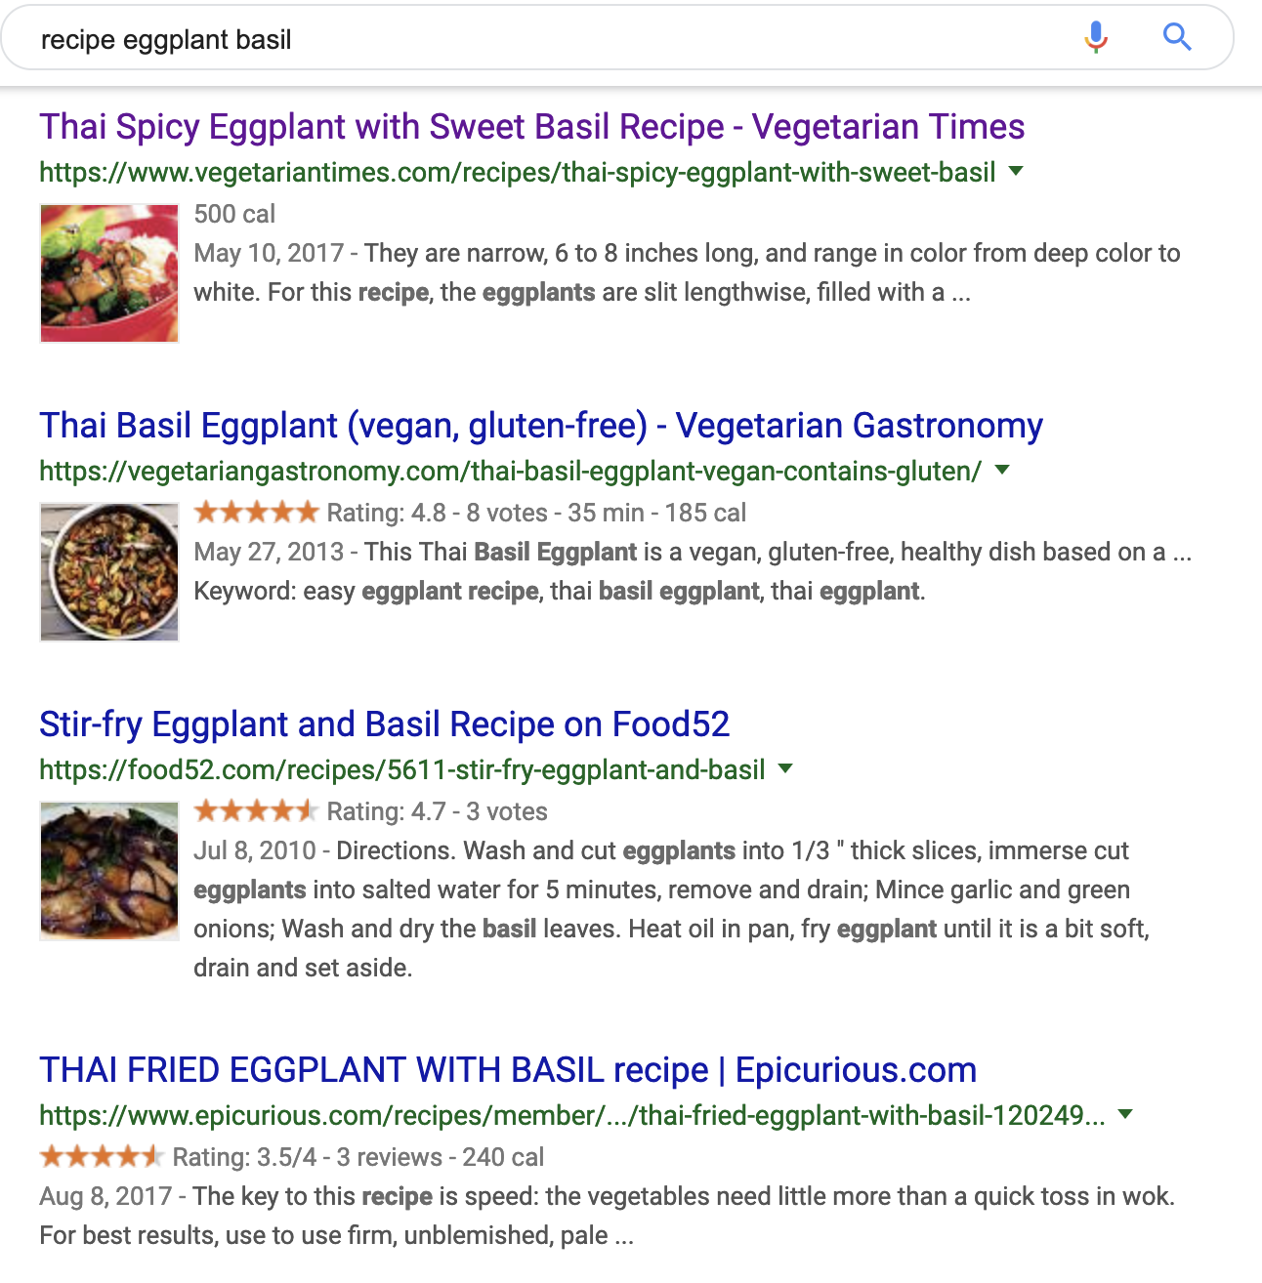
Inconveniences in Recipe-Searching
Countless Search Results
Eggplant
Tomato
Basil
Leftover Produce
Typical Procedure
Visit each website
Repetitive check for
Ingredients?
Prep. Time? Method?
Nutrients? etc.
3. Select a recipe!
(~30-min later)

Slide 3


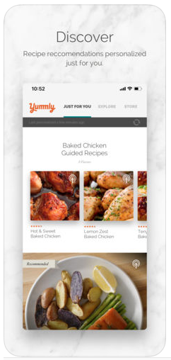
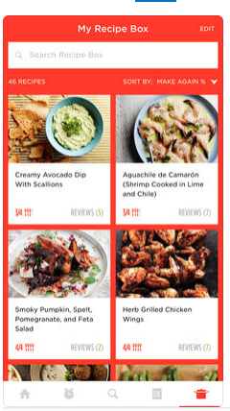


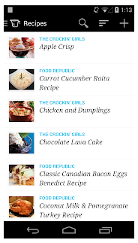
Other Options in Recipe-Searching?
Leftover Produce
Too many:
Options
Functionalities

Slide 4


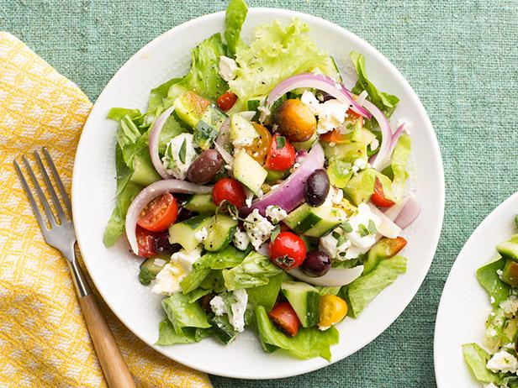
Let’s Build One from Scratch!
Personalized Criteria:
Dish-types
Keto-friendly
image recognition
Leftover Produce
Greek Salad

Slide 5
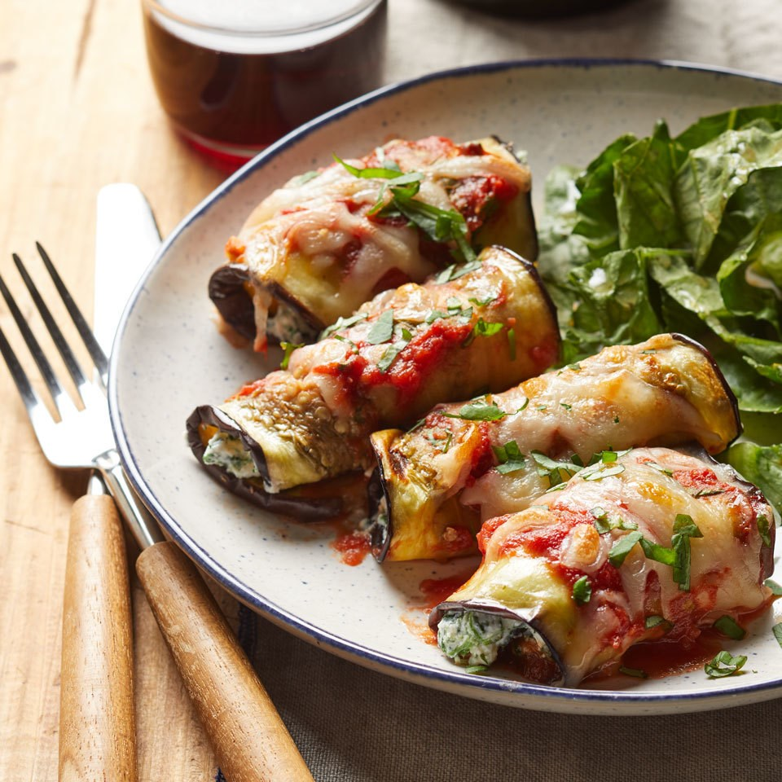


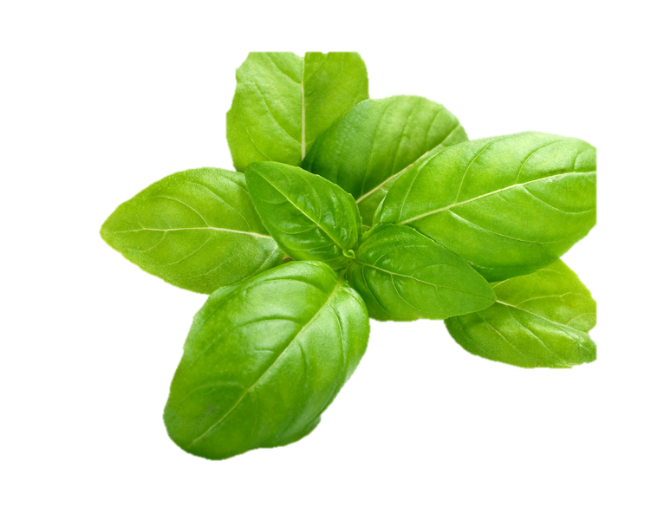
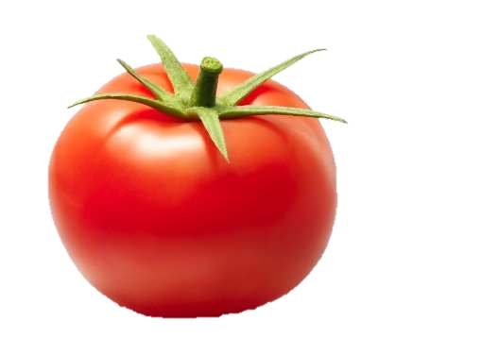
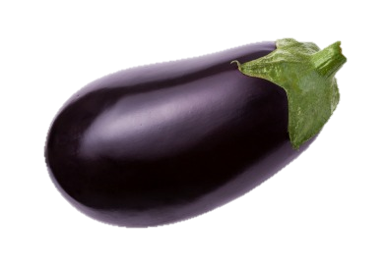
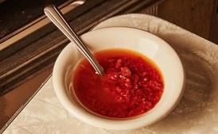




Project Design & Workflow
Data Acquisition
web-scraping
Instructions
Ingredients
Nutrients
Images
Text
Preprocessing,
Engineering
Modeling
Main Dish
Image Classification
(CNN)
NLP
Topic Modeling
(NMF)
Appetizers
Eggplant Rolls
Desserts
Condiments
etc.
Salads
Joining
Text
Tagged-
Documents
Web
Application
BeautifulSoup
Eggplant Picante Sauce

Slide 6

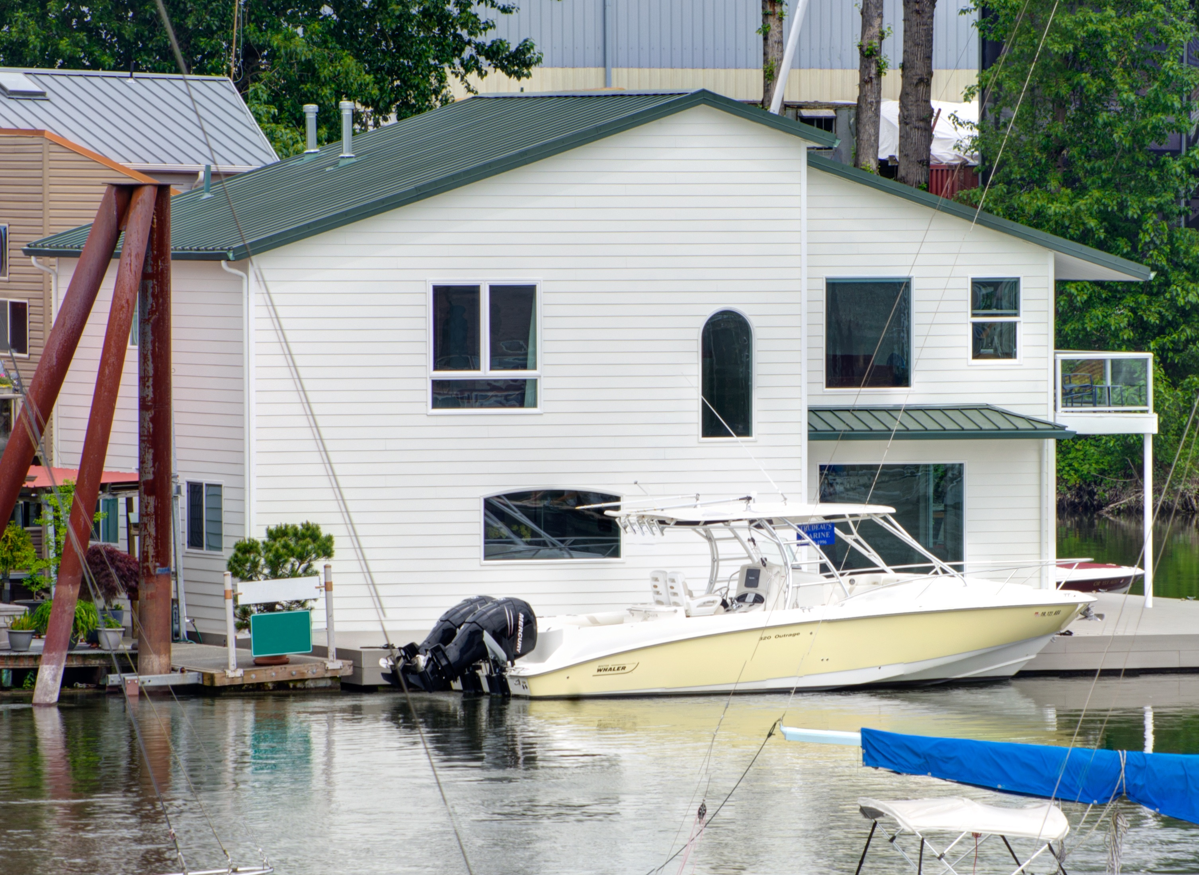
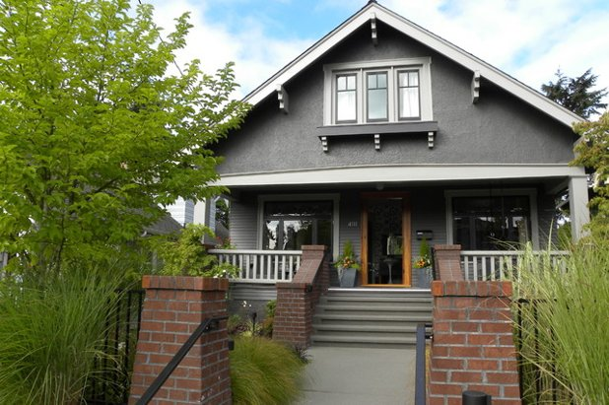


Other Applications
Data Acquisition
Other
Databases
Images
Text
Preprocessing,
Engineering
Modeling
Victorian
Image Classification
(CNN)
NLP
Topic Modeling
(NMF)
Craftsman
Modern-Style Home
Modern
Colonial
Country
Joining
Text
Tagged-
Documents
Web
Application
BeautifulSoup
Craftman-Style Home

Slide 7
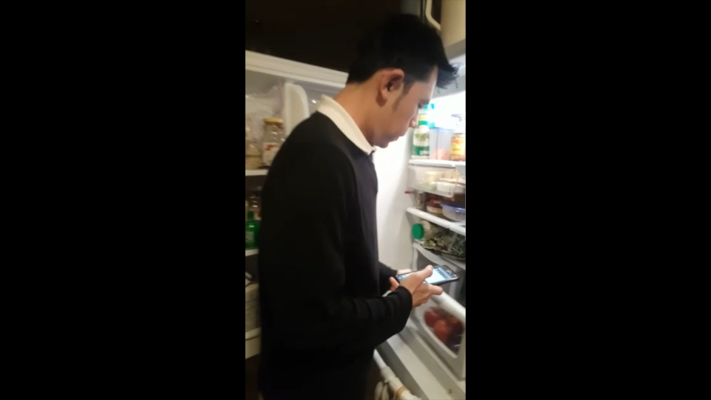
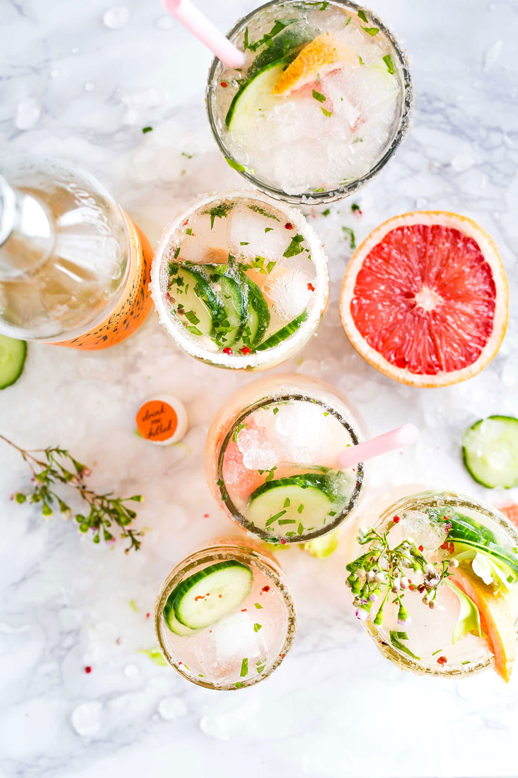

Prototype Demo
Result & Future Work
Classify 12 classes with ~95% accuracy
NLP for recipe categorization
Dish-type (5 categories).
Overlapping ingredients
3-ingred.
2-ingred.
1-ingred.
1-ingred.
1-ingred.
Topic modeling improvement
“Real-time” video detection
Dessert?
Larger database
coming soon!!!
Picante Sauce

Slide 8



Sometimes…
“If you can’t find an answer anywhere…
…make it up! ~Anonymous
Produce-2-Recipe
Jhonsen Djajamuliadi
Data Scientist | Data Analyst
jhonsen
jhonsen

Slide 9
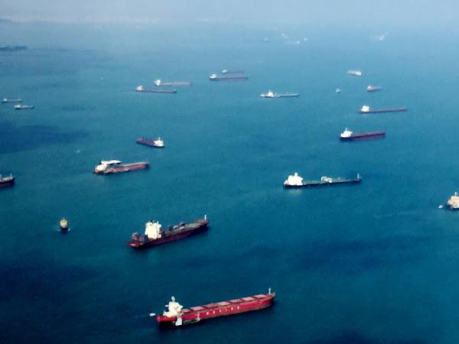
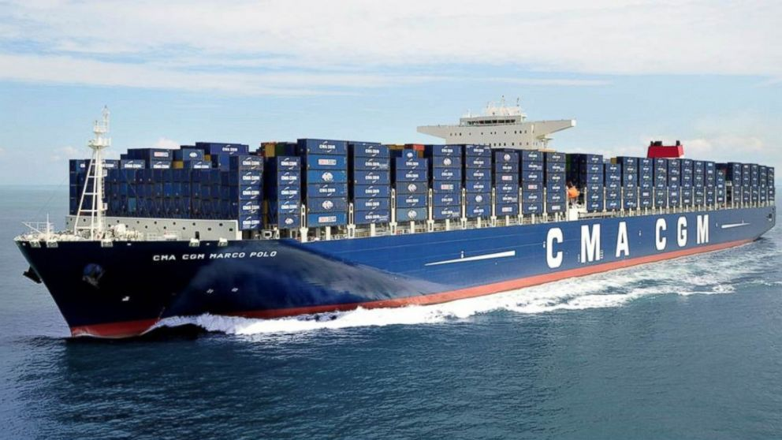
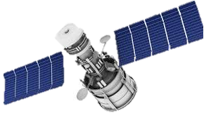

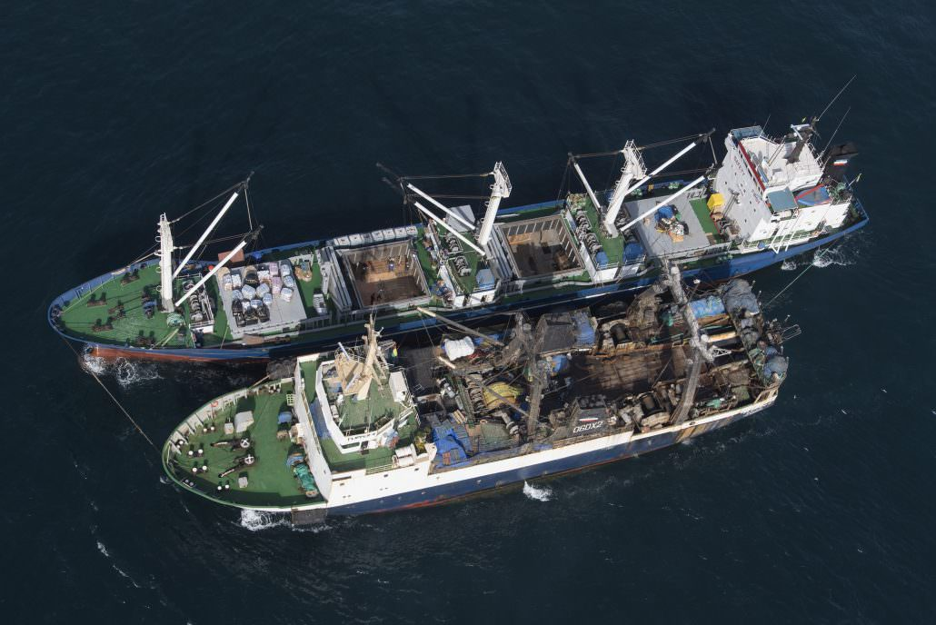
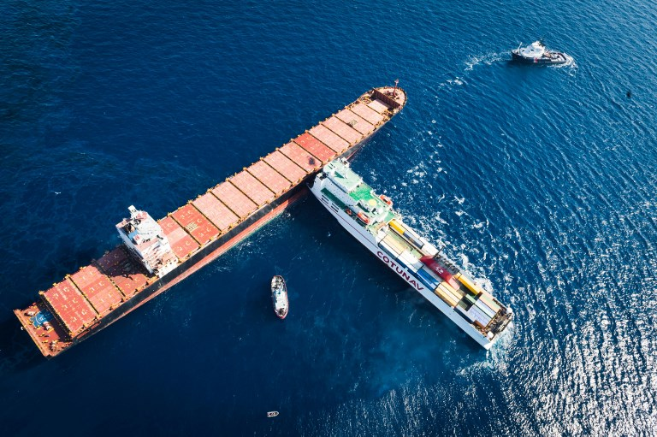
Other Applications
Data Acquisition
Other
Databases
Images
Text
Preprocessing,
Engineering
Satellite
Modeling
Image Classification
(CNN)
NLP
Topic Modeling
(NMF)
Cargo
Ship Traffic
Yacht
Fishing
Cruise
Joining
Text
Tagged-
Documents
Web
Application
BeautifulSoup
Cargo Ship

